Slide 1
Gymnastics: Traditional Tales
Year One
PE | Year 1 | Indoor | Gymnastics: Traditional Tales | The Three Little Pigs | Lesson 2

Slide 3
Aim
To travel in different ways, changing speed and direction.
Success Criteria
I can travel in different ways.
I can change speed and direction as I am travelling.
I can describe my own performance.
I can perform a range of controlled balances.

Slide 4
Let’s Get Ready

Slide 5
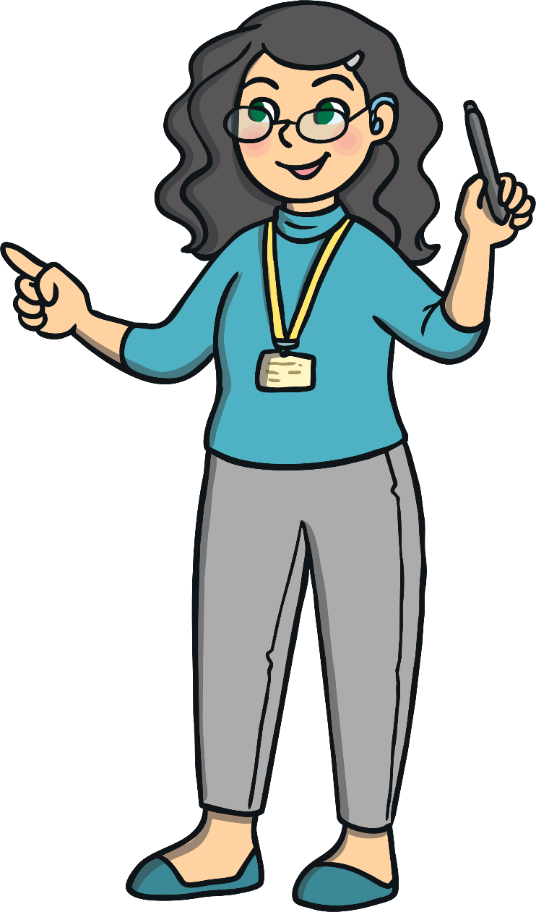
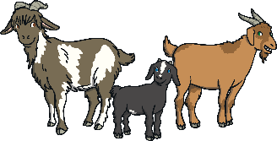
Traditional Tales
In our lesson, we used the word contrasting to describe some of our movements and balances.
In this unit, we are using some different traditional tales to help us with our learning.
Can you remember which story we used in our last lesson?
big
narrow
small
wide
We used the story of The Three Billy Goats Gruff.

Slide 6
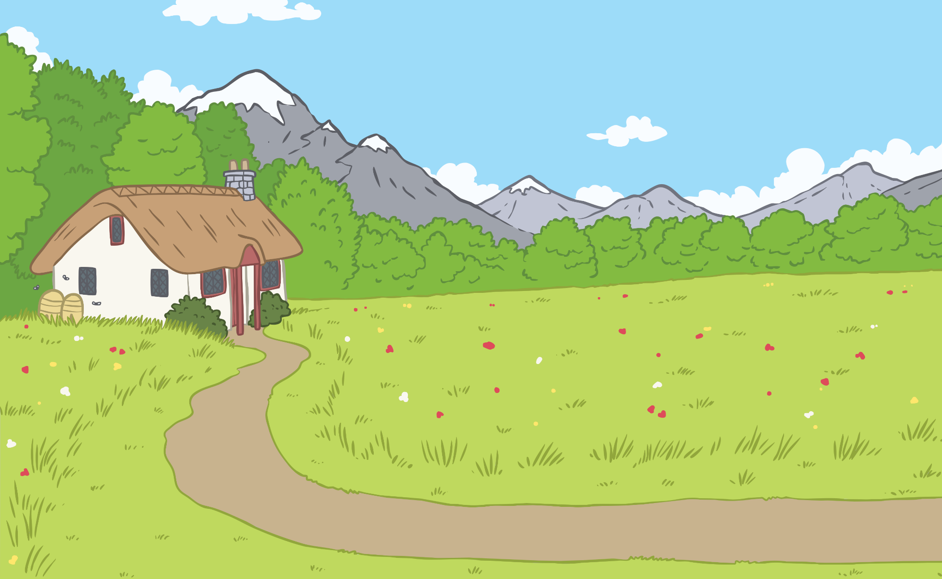
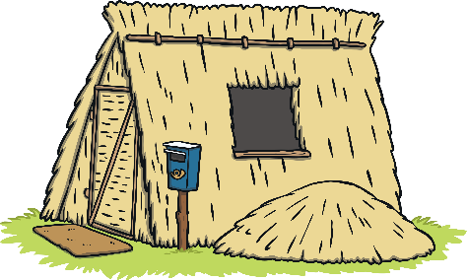
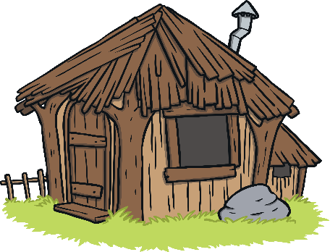
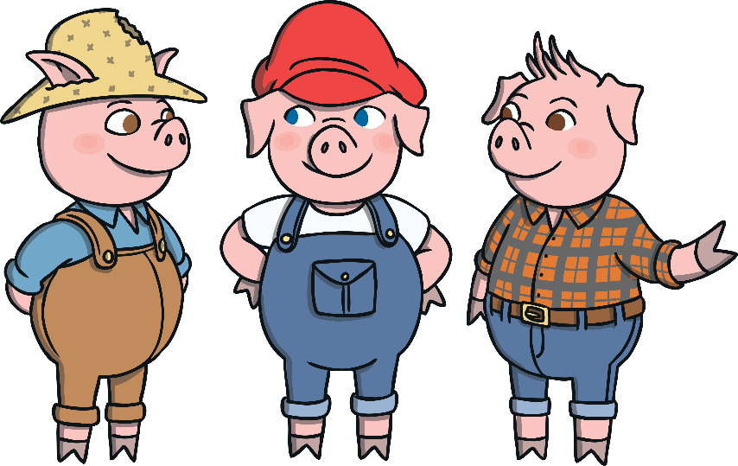
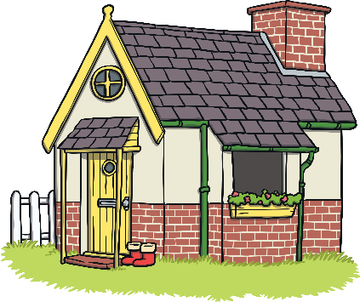
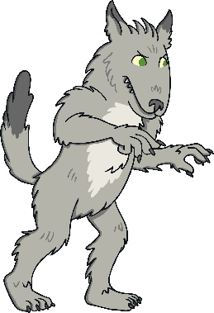
The Three Little Pigs
Traditional Tales
Can you guess which story we are going to use in our lesson today?
Talk to your partner about what happens using these pictures to help you.
The Three Little Pigs.
What do you know about this story?

Slide 7
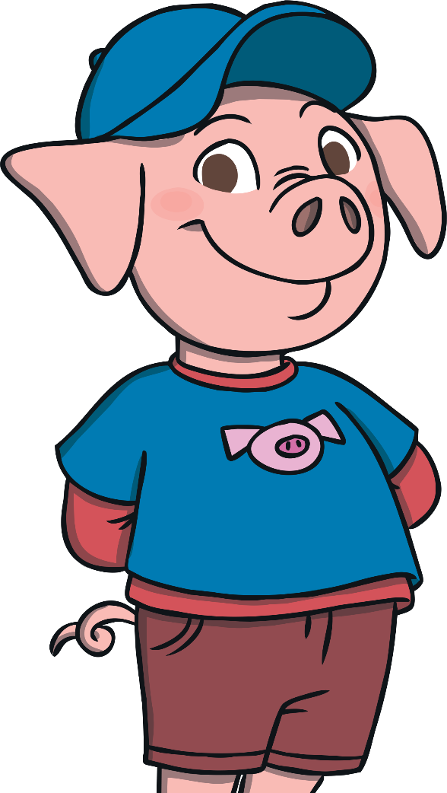
The Three Little Pigs
The three little pigs built their houses using different materials.
The house made of bricks was the strongest and the wolf couldn’t blow it down.
Which house was the strongest?

Slide 8
Let’s Get Moving

Slide 9
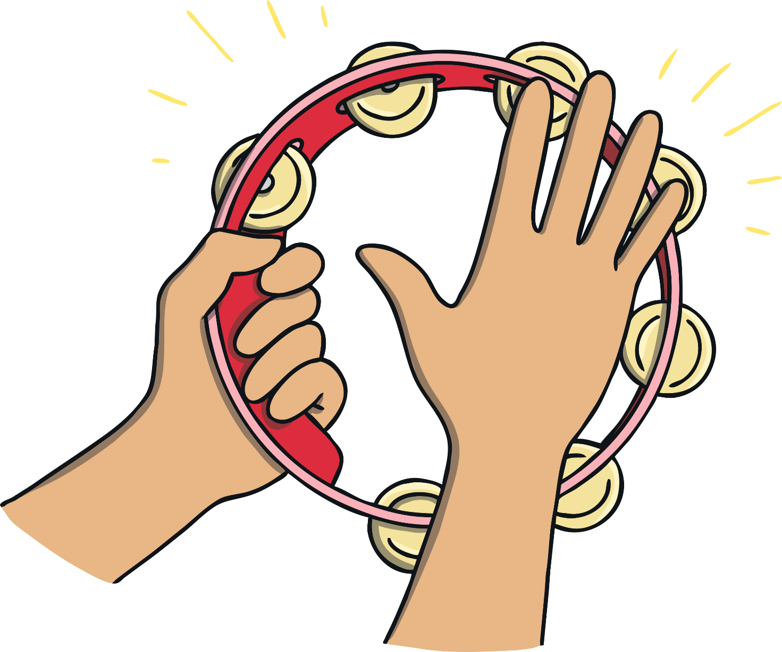
Warm-Up: Listen Carefully
To get our bodies warm, we are going to move around the room. You need to listen carefully to your teacher playing the tambourine.
The tambourine will shake at different speeds to tell you how fast to move.
When your teacher bangs the tambourine, you need to change direction.

Slide 10
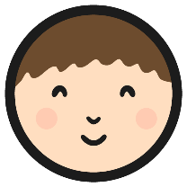
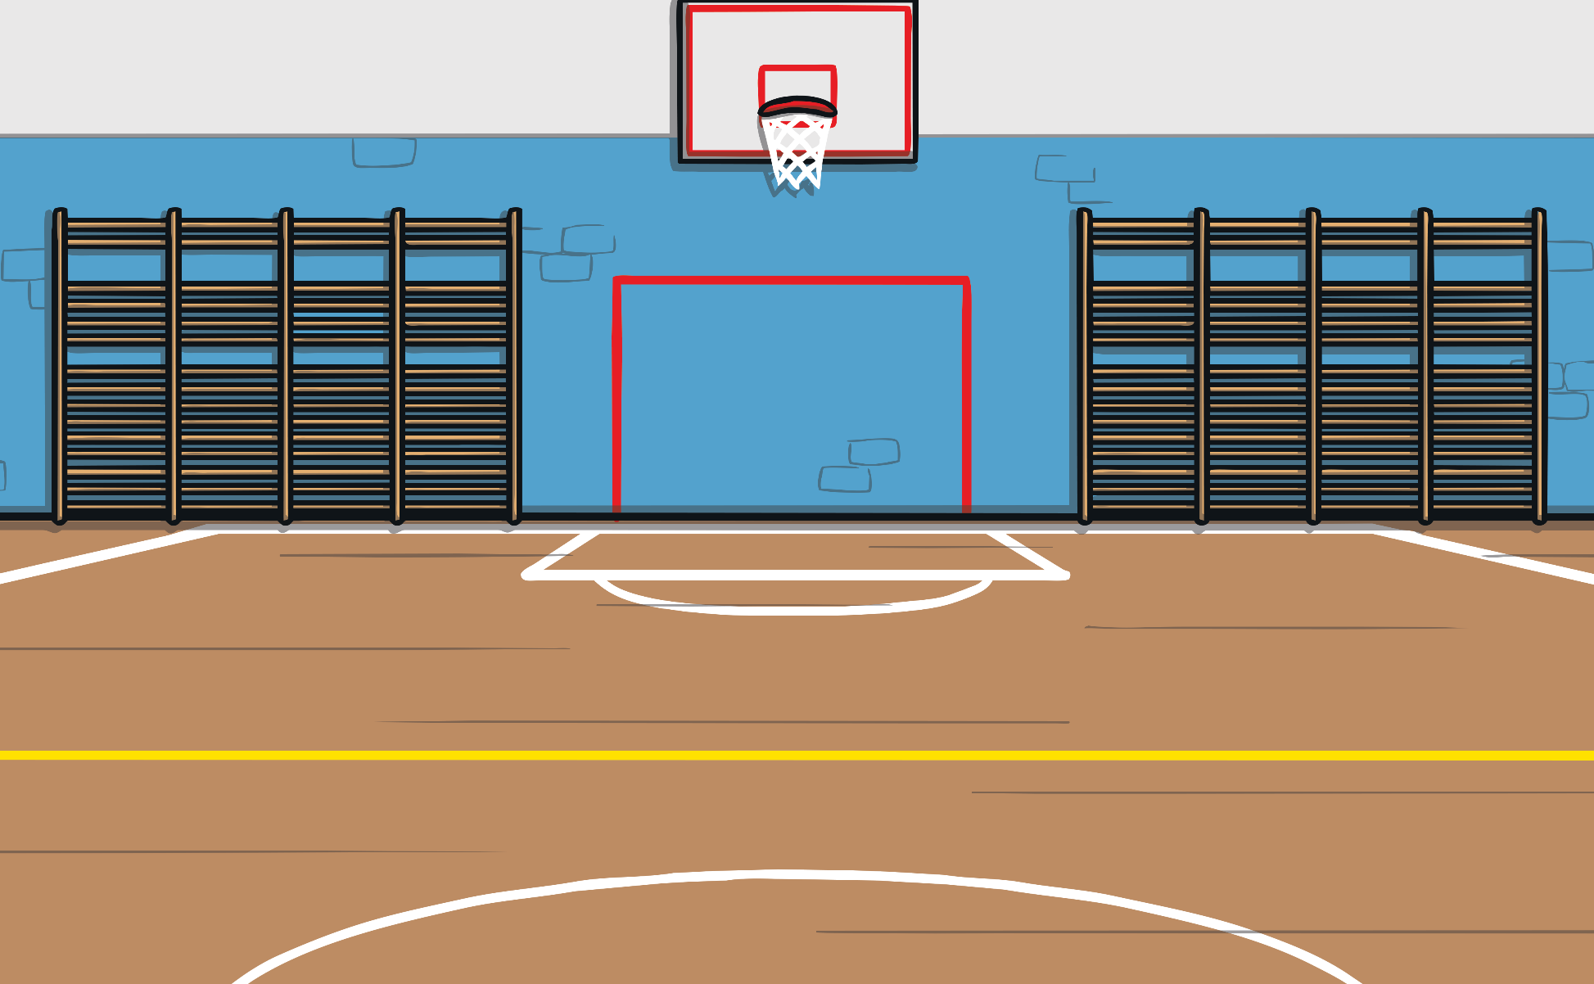
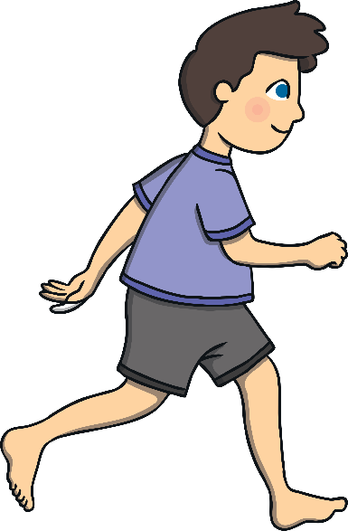
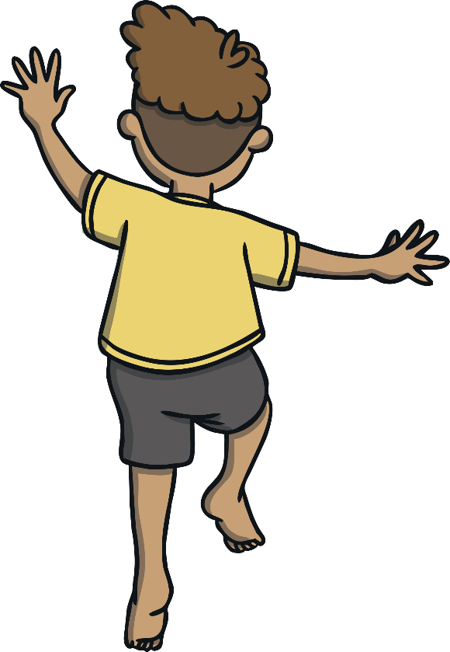
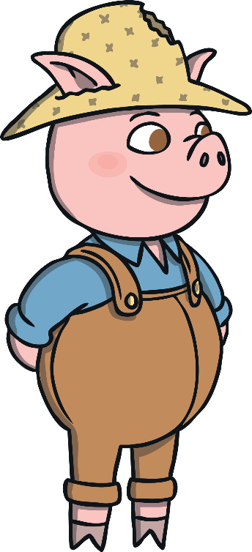
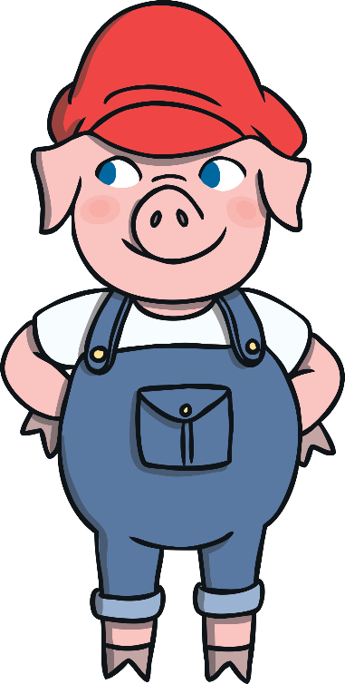
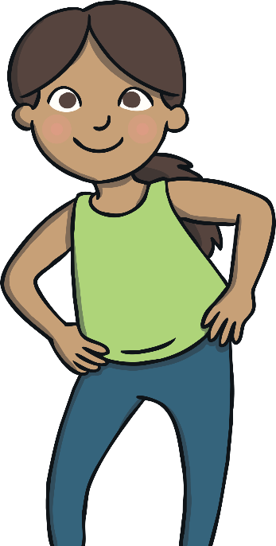
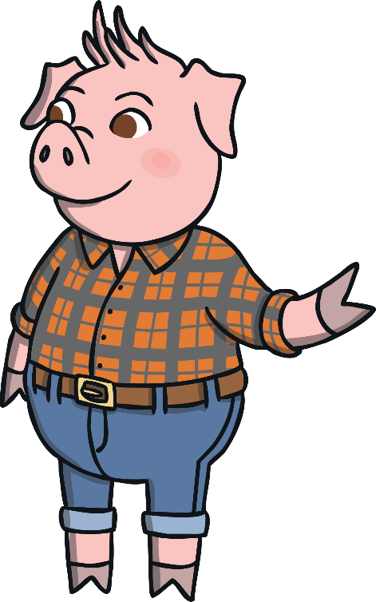
Travelling
Today, our lesson is going to focus on travelling. We have already used walking and running in our warm-up activity.
Choose three of your travelling movements, one to represent each of the three little pigs.
How many other ways can you travel around the room?
Can you change the speed of your travelling movements?

Slide 11
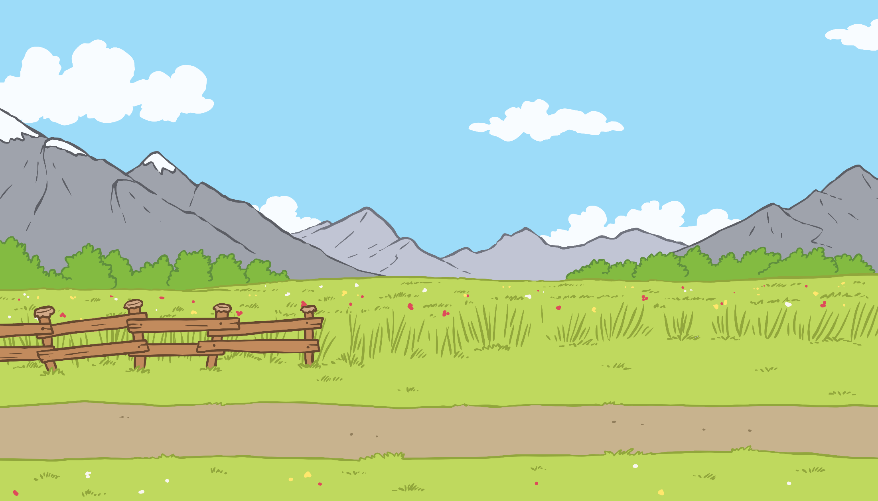
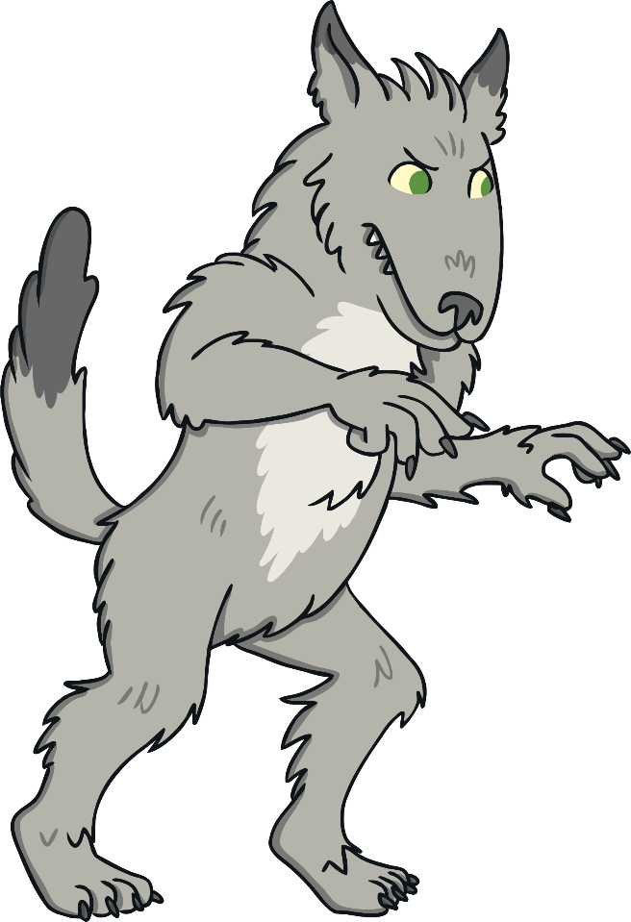
The Wolf
Look at this picture of the wolf. He is sneaking up to the house to try and blow it down.
Which part of his foot is he travelling on?
Can you travel around the room on your tiptoes like the wolf?
He is travelling on his tiptoes.

Slide 12
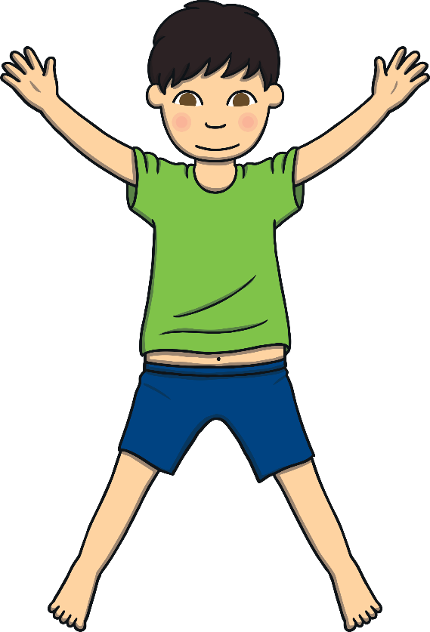
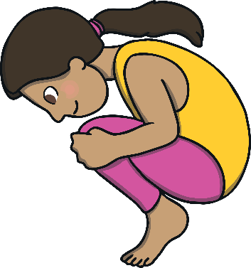
Can You Remember?
In our last lesson, you practised making these body shapes.
Can you remember what each shape is called?
star
tuck
straight

Slide 13
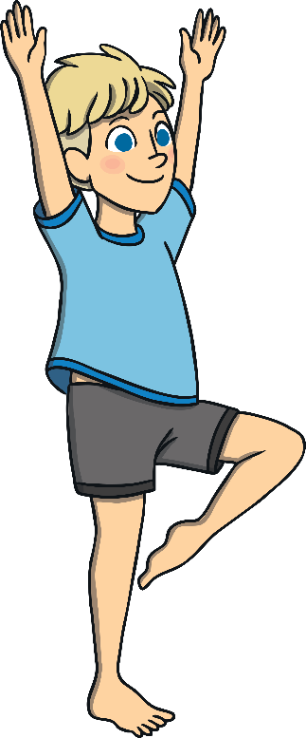
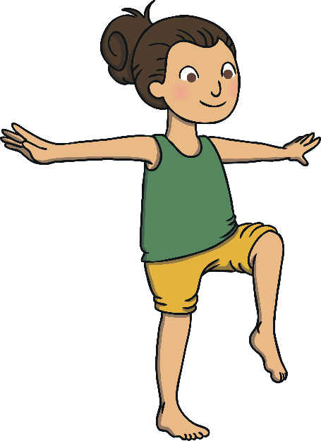
Can You Remember?
You used these body shapes to create some interesting balances.
You balanced on your tiptoes.
You lifted one leg off the ground.
You used your arms to create an interesting shape and to help you to balance.
Now try practising these three balances.
Can you balance in a bridge shape?

Slide 14
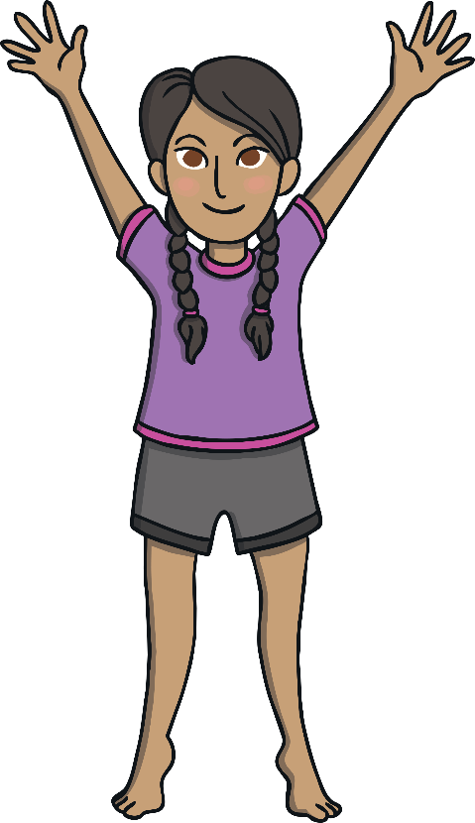
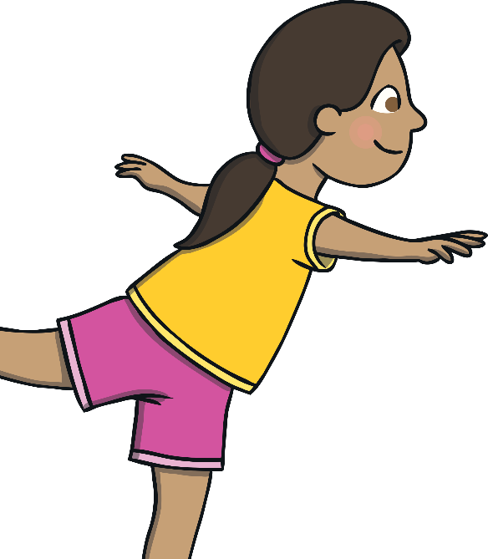
Can You Remember?
At the start of the lesson, we looked at pictures of the houses built by the three little pigs.
In gymnastics, it is important to make our balances strong like the brick house. We used three words to help us to remember how to make a strong, controlled balance.
Which house was the strongest?
Now, practise your balancing again, remembering the keywords: still, stretch and stay.
It was the brick house.
Stay in position for a few seconds to show your clear body shape.
Tense your muscles to hold your balance still.
Stretch the parts of your body as much as you can.

Slide 15
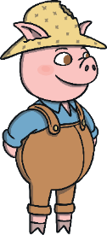
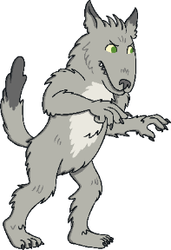
Time to Perform
Now you are ready to perform a sequence using the skills that you have practised.
In your sequence, you will travel and balance.
Travel
Tiptoe
Balance
Travel
Travel
Tiptoe
Balance
Balance

Slide 16
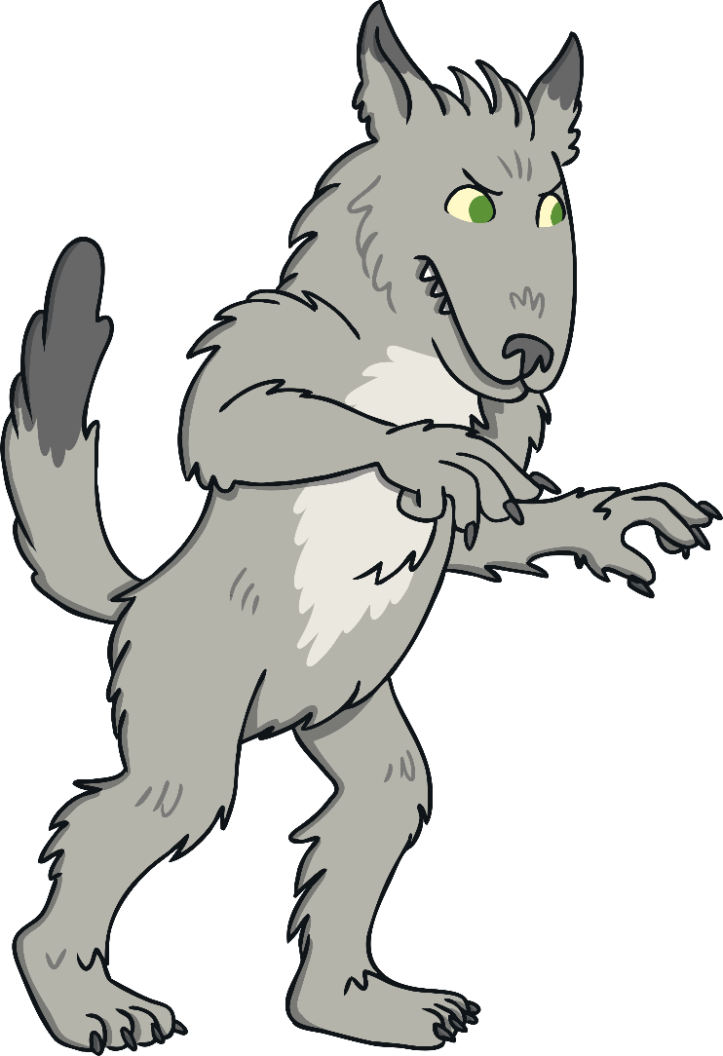
Cool-Down: The Three Houses
To cool our bodies down, we are going to be the three houses of the little pigs.
Your teacher will be using a percussion instrument to make the sound of the wolf trying to blow down each house.
straw
sticks
bricks
On your way back to the classroom, can you tiptoe like the wolf?

Slide 17
Let’s Review

Slide 18
Strong Balances
Today, you performed some balances that were strong like the brick house.
Can you tell your partner what they need to remember for a strong, controlled balance?
Use our three keywords to help you.
still
stretch
stay

Slide 19
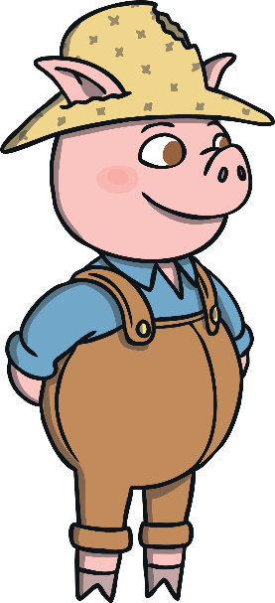
Travelling
You have travelled in lots of different ways today.
Can you tell your talking partner which travelling movements you chose for your sequence today?
Which travelling movement did you use at the end of your sequence?

Slide 20
Aim
To travel in different ways, changing speed and direction.
Success Criteria
I can travel in different ways.
I can change speed and direction as I am travelling.
I can describe my own performance.
I can perform a range of controlled balances.

