Slide 1

Whitwell 2019
http://www.whitwellhall.org/
Please visit the website

Slide 4
Magic fruit bowl that is always full
Water and squash available throughout the day
Can pack snacks - children are responsible for these

Slide 5
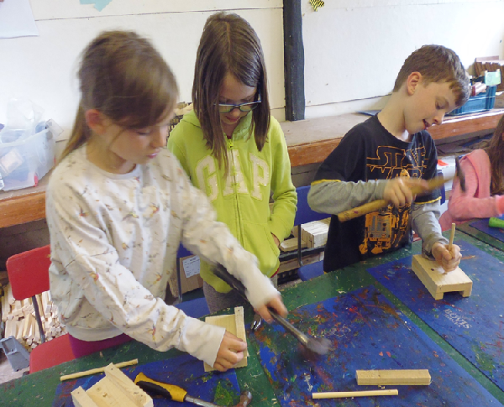
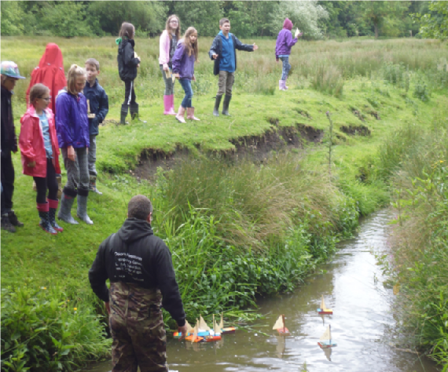
Activities
Boat Building
Boat Race

Slide 6
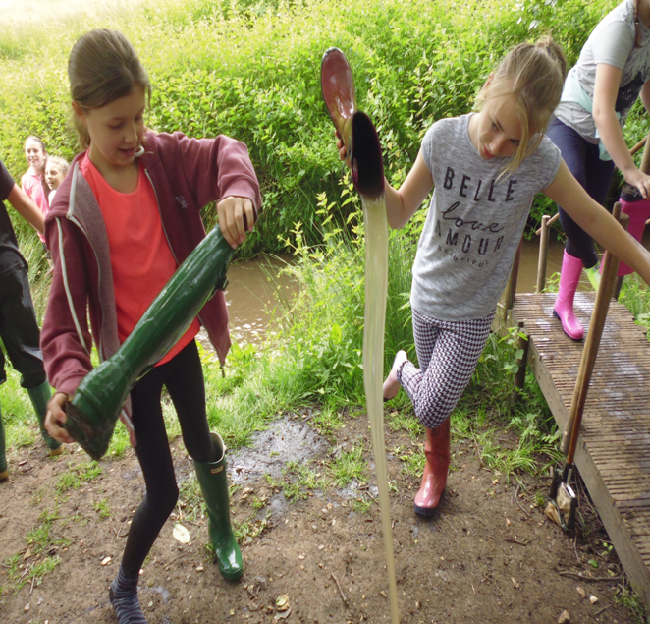
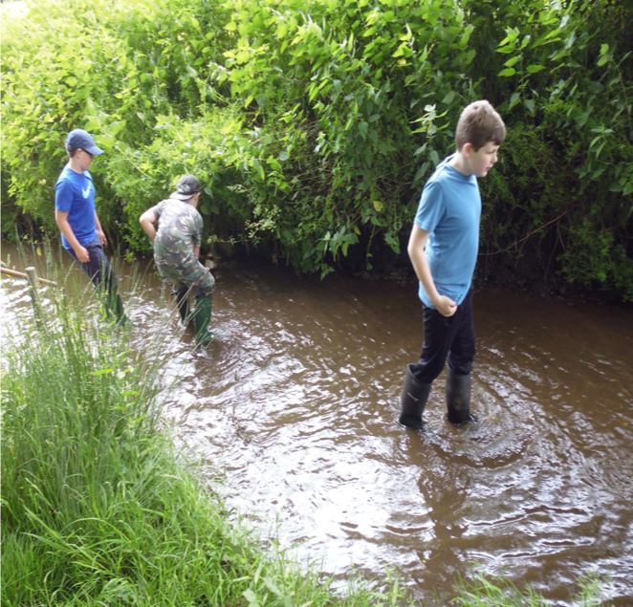
River Dipping

Slide 7
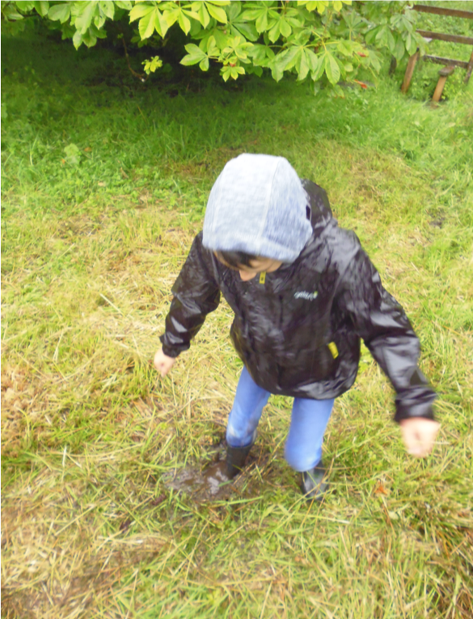
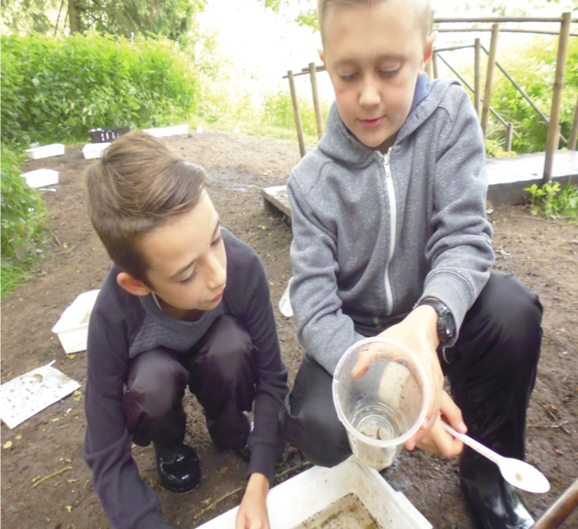
Can be muddy!

Slide 8
Top Tips
Wellies (decent height not ankle ones – don’t do too well in the river!)
Outdoor clothes: sitting around a campfire; walking through long grass
Get muddy/wet probably many times so plenty of clothes
Chilly evenings / mornings then hot in the middle of the day.
Mainly outside whatever the weather
Indoor shoes / slippers
DON’T pack expensive/fashion clothes!
High grass / high thistles / nettles / gorse in parts so rugged-long sleeved tops and trousers
Saying all of this it could be a heatwave
Enjoy, enjoy, enjoy

Slide 9
Staffing
House:
Mary (Sendco / Yr2/3 Frettenham)
Roxy (4/5/6 teacher Frettenham)
Emily (yr3/4 teacher St. Faiths)
Camping
Mr Cross (HoS Hainford)
Aiden (TA St. Faiths)
Emma ( St Faiths)
Most activities are run by Whitwell staff
Additional staff from all three schools will be present during the day and evening
Whitwell staff are available at night if required

Slide 10
Any questions?

